Slide 1
PROJECT ON CURRENCY CONVERTER
By
Akshat Verma (E21331038900005)
Shivanshu (E21331038900002)
Yogendra Kumar (E21331039000003)
Ashish Kumar pal (E21331039000005)
Branch : CS & IT

Slide 2
INTRODUCTION
A Currency Converter is a calculator that converts the value or quantity of one currency into the relative values or quantities of other currencies. For example, if I had 100rs that needed to be exchanged into the local currency of a country I am visiting, I would need to know the Rupees-Dollar conversion, if I were traveling to certain parts of Europe, the Dollar-pound conversion.
In this project by the knowledge of usage of currency converter a program is designed in java language.

Slide 3
ALGORITHAM
Step 1: Start the Program.
Step 2: Select the currency from and to.
Step 3: Enter the amount value.
Step 4: Click on the convert button.
Step 5: The value will be displayed.
Step 6: Exit.

Slide 4
DISCRIPTION
System Module
Discription
Convert Module
Switch Module
Exit Button
it will convert one currency into another currency after input a number and choice two currencies that one's want to convert.
It will switch the value you entered.
It will close the program.

Slide 5
DESIGINE
We are using different method to create this program.
We created some packages to change money like INR to Dollar, Dollar to INR etc.
We used “Java Abstract Window Toolkit” to make buttons , levels ,textfields etc.
We used Java applets to provide interactive features to web applications.

Slide 6
STEP I FOLLOWED
Step 1: Creating a JFrame using Abstract Window Toolkit (AWT).
Step 2: Forming a design using AWT such as Button, level, text field combo box etc.
Step 3: Make sure all buttons are working.
Step 4: Write down the action performed of all the components.
Step 5: Removing Bug.
Step 6: Run and execute the program.

Slide 7
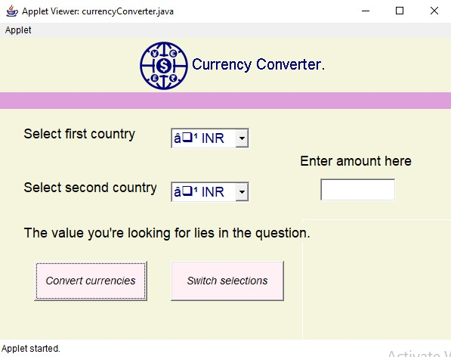
HOW TO USE
Open the Program.

Slide 8
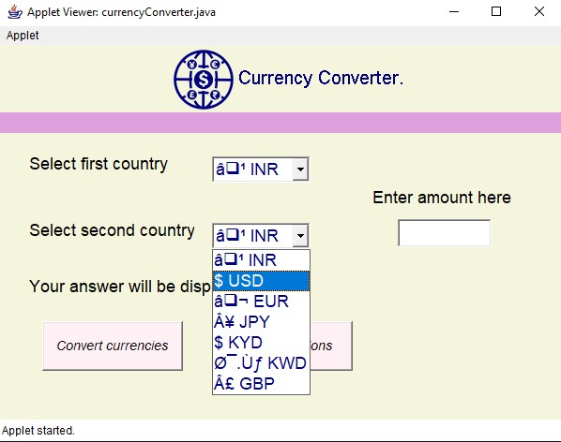
Enter the currency you want to convert

Slide 9
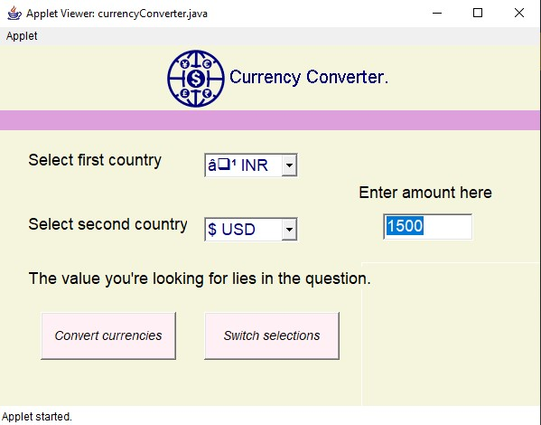
Enter Amount

Slide 10
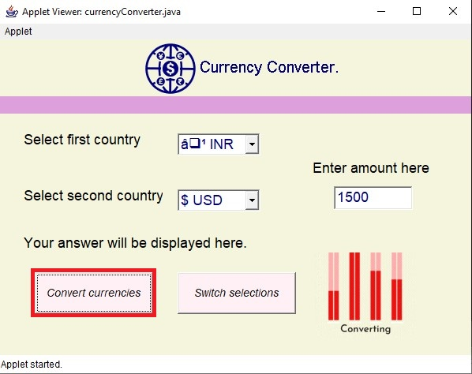
Click on the Convert button. it will take some time to progress.

Slide 11
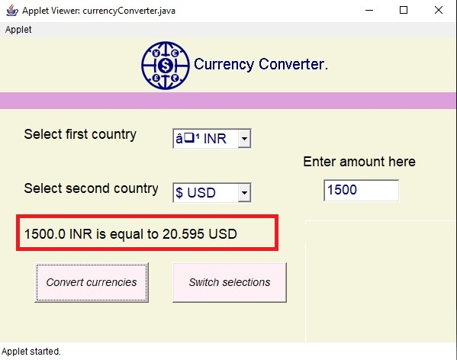
Answer has been displayed.

Slide 12
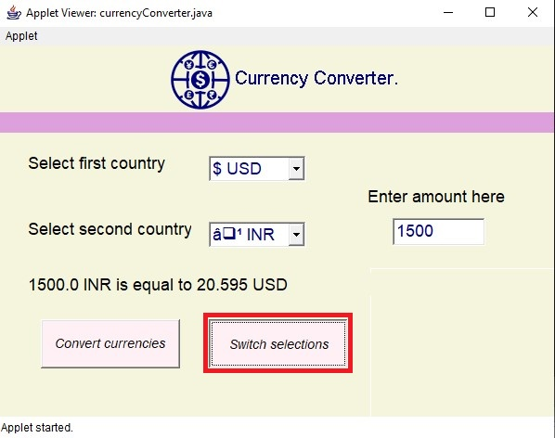
You can also switch currencies.

Slide 13
FUTURE SCOPE
Integration with mobile devices: With the growing use of smartphones and tablets, currency converters are likely to become more mobile-friendly.
Mobile apps will be developed to help users convert currencies on the go.
Multi-currency support: Currency converters may start supporting multiple currencies, which will be especially useful for people who travel to multiple countries or conduct business with international clients.

Slide 14
CONCLUSION
currency converter that the people are using, they will always find ways to get the highest possible profits out of the exchanges. To those who are going to travel, it is a wise thing to check the different foreign exchange options they have beforehand.

Slide 15
THANKS.

